Slide 1
Does WIMD 2025 adequately capture rural deprivation in Wales and what are the implications for rural-proofing policy?
Data and Methods:
1,917 Welsh LSOAs · WIMD 2025 Ranks, Scores, Deep-Rooted Deprivation, ONS RUC 2021

Slide 2
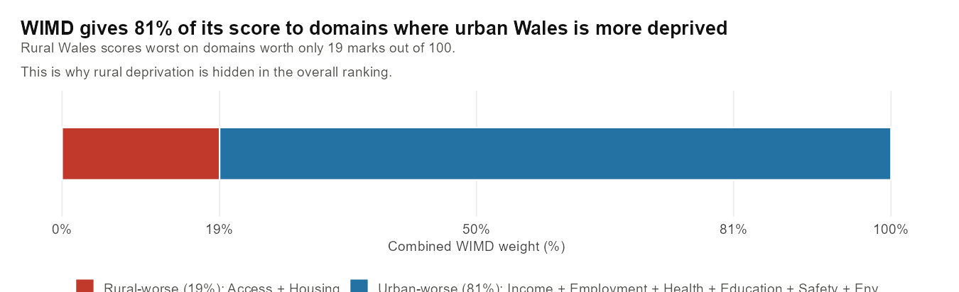
19% 81%
Rural-worse domains Urban-worse domains
Access (10%) + Housing (9%) Income · Employment · Health Education · Safety · Env.
Rural areas score worst on the lowest-weighted domains.
The weighting structure — not deprivation — decides who appears in the ranking.

Slide 3
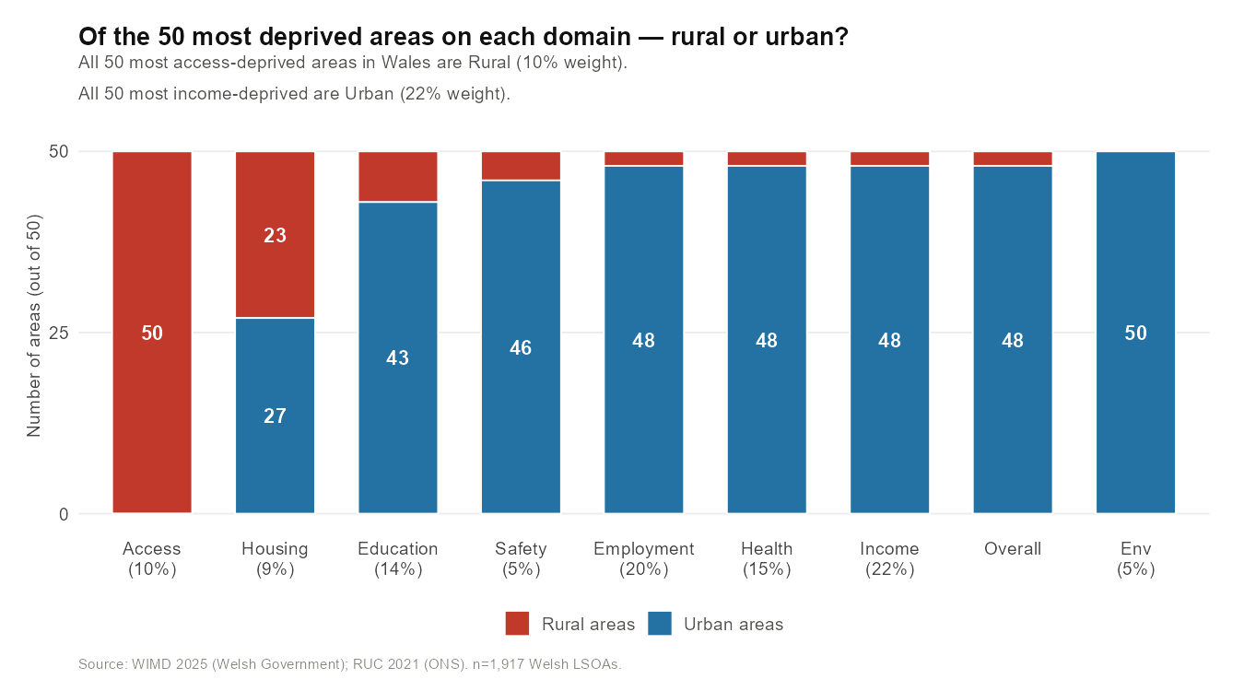
Rural areas dominate the access domain. Urban areas dominate income.
50 of 50
most access-deprived areas are Rural
(access = 10% of WIMD score)
2 of 50
most income-deprived areas are urban
(income = 22% of WIMD score)
Rural deprivation is real but concentrated in the lowest-weighted domain.
Urban deprivation dominates the highest-weighted domain.

Slide 4
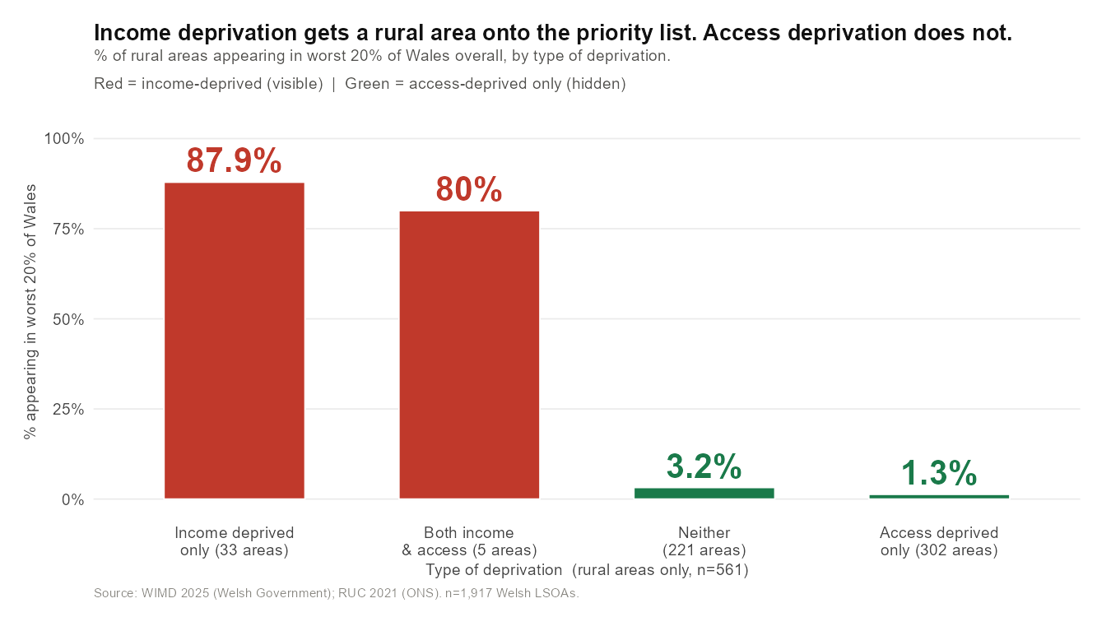
Income deprivation is visible in WIMD. Access deprivation is not.
302 rural areas are severely access-deprived — only 1.3% appear in worst 20% overall.
The weighting structure, not the severity of deprivation, decides visibility.

Slide 5
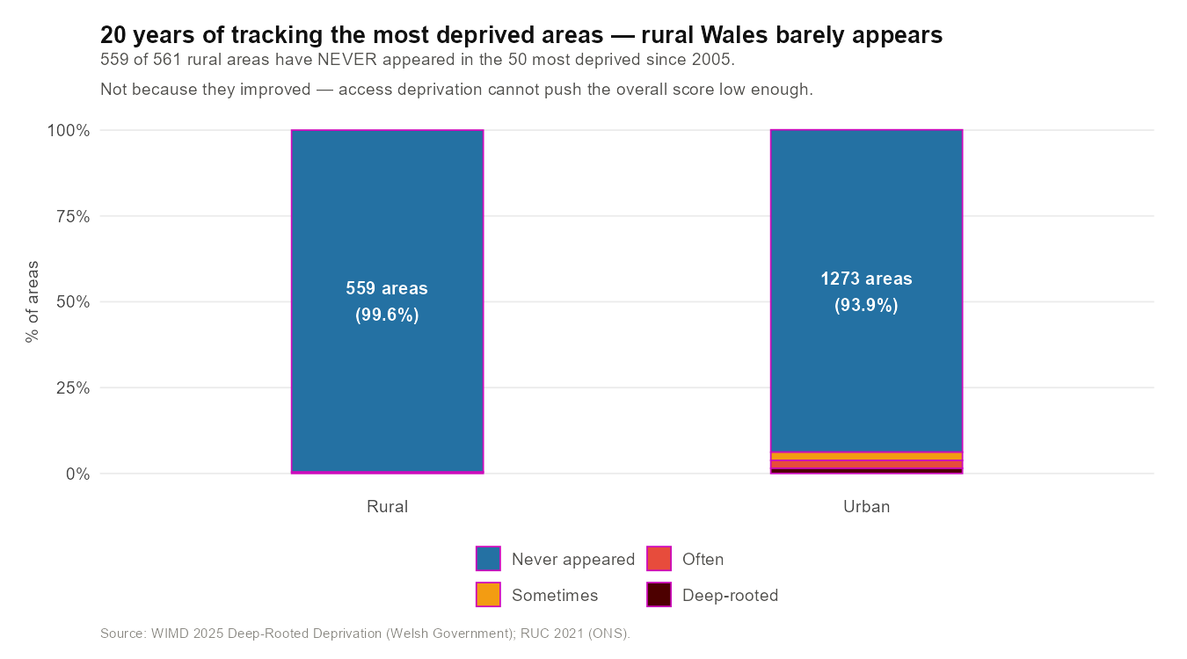
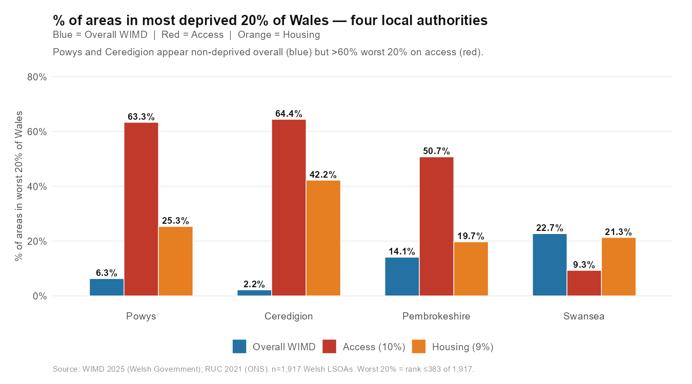
Ceredigion: 2.2% deprived overall — yet 64.4% worst 20% on access.
20-year tracking (2005–2025)
559 of 561 rural areas NEVER appeared in the 50 most deprived
147 rural areas worst 20% on BOTH access and housing — 0% visible
Structurally invisible in WIMD for 20 years
Local authority case studies
Ceredigion: 2.2% overall → 64.4% worst 20% on access
Powys: 6.3% overall → 63.3% worst 20% on access
190 communities worst 10% on access — 0% appear in overall worst 20%

